Slide 1
Real World Scalability
Dallas C# Sig – 5/5/2016
Mark Doyle

Slide 2
What is Scalability?
Writing better or more performant code | Thoughtful, efficient code Asynchronous programming Parallelism
Implementing improved architecture or design | Data / calculation storage Disconnected / async processing Caching Compression
Hardware or environment solutions | Scale up Scale out

Slide 3

Asynchronous Programming
Async / Await
PROS | CONS
Frees up main thread during network/storage operations Beneficial for network- or storage-intensive solutions | Challenging to partially implement Deadlocking potential Thread pool management performance Little benefit to single-threaded or CPU-intensive solutions

Slide 4


Parallelism
Without async / await
With async / await

Slide 5

Caching
In-memory caching
PROS | CONS
Readily-accessible objects & data Faster access than network-based resources | Memory pressure expiring cache Stale objects

Slide 6
Caching (continued)
Distributed cache
(e.g., Redis)
PROS | CONS
Cache accessible to numerous processes / machines | Network-based resource

Slide 7
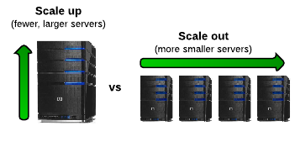
Scaling
PROS | CONS
Better performance | Cost Idle hardware (unless auto-scaling)

Slide 8
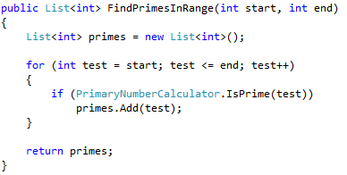
Problem 1 – CPU Bound Operations
Example: Primary number calculation

Slide 9
Problem 1 – CPU Bound Operations
Solution 2: Async/await, no caching
Solution 3: Caching, no async/await
Solution 4: Caching, with async/await

Slide 10
Problem 1 – CPU Bound Operations
Results
Async with caching is most performant
Async without caching is least performant
# | Cached | Async | Avg Time | Total Tests | Test Time
1 | No | No | 0.21 | 2,534 | 532
2 | Yes | No | 0.20 | 2,487 | 497
3 | No | Yes | 0.24 | 2,489 | 597
4 | Yes | Yes | 0.14 | 2,454 | 344

Slide 11
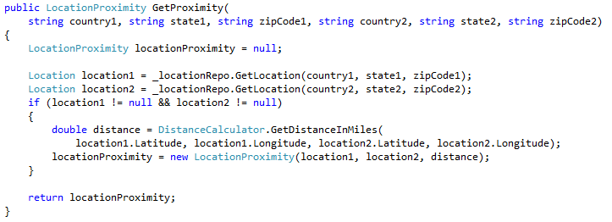
Problem 2 – Storage Read with CPU
Example: Proximity calculation between two locations

Slide 12
Problem 2 – Storage Read with CPU
Solution variables
Synchronous versus async/await
Storing results
Caching
Pre-loading locations

Slide 13
Problem 2 – Storage Read with CPU
Results
# | Stored | Cached | Async | Pre-load | Avg Time | Total Tests | Test Time
1 | No | No | No | No | 0.27 | 2,190 | 591
2 | Yes | No | No | No | 0.27 | 2,224 | 600
3 | Yes | Yes | No | No | 0.26 | 2,076 | 540
4 | Yes | Yes | No | Yes | 0.26 | 2,146 | 558
5 | No | No | Yes | No | 0.32 | 2,153 | 689
6 | Yes | No | Yes | No | 0.32 | 2,123 | 679
7 | Yes | Yes | Yes | No | 0.23 | 2,087 | 480
8 | Yes | Yes | Yes | Yes | 0.22 | 2,106 | 463

Slide 14
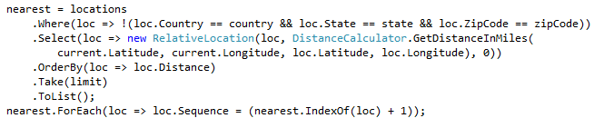
Problem 3 – Large Dataset Calculations
Example: Find closest locations

Slide 15
Problem 3 – Large Dataset Calculations
Solution 2: Async/await, no caching
Solution 3: Caching, no async/await
Solution 4: Caching, with async/await

Slide 16
Problem 3 – Large Dataset Calculations
Results
Async without caching was more performant
# | Cached | Async | Avg Time | Total Tests | Test Time
1 | No | No | 0.27 | 2,085 | 563
2 | Yes | No | 0.27 | 2,139 | 578
3 | No | Yes | 0.24 | 2,056 | 493
4 | Yes | Yes | 0.32 | 2,104 | 673

Slide 17
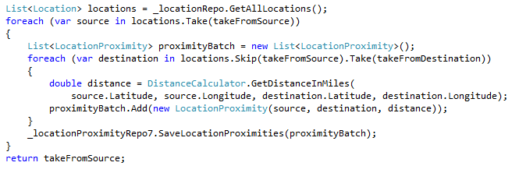
Problem 4 – Storage Bound Operations
Example: Calculate proximity of range of locations
Solution 2: Async/await

Slide 18
Problem 4 – Storage Bound Operations
Results
Async was more performant
# | Avg Time | Total Tests | Test Time
1 | 2.73 | 273 | 745
2 | 2.66 | 248 | 660

Slide 19
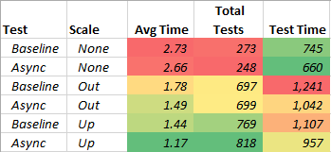
What About Scale?
Scaling UP amplified caching & async improvements
more than scaling OUT

Slide 20
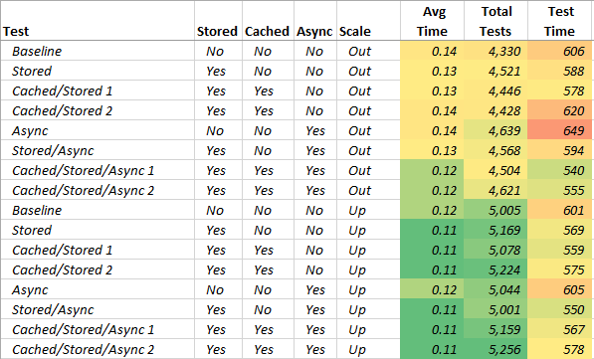
More Scaling Results

